Slide 1

SESHADRI RAO GUDLAVALLERU ENGINEERING COLLEGE DEPARTMENT OF ELECTRONICS AND COMMUNICATION ENGINEERING
An IOT Project On
REMOTE MONITORING OF PERISHABLE GOODS BY USING IOT
Presented By :
K. Sai Pavan Durga(20485A0407)
G. Vinay Kumar (19481A0467)
K. Naga Valli (20485A0409)
K. Mani Sri (19481A04A5)
K. Sai Surya Ganesh(19481A04A4)

Slide 2
ABSTRACT
The main reason for “Remote Monitoring Of Perishable Goods Using lot ” is improper temperature control.
It is a key reason for why medicines like vaccinations and other perishable goods are wasted in the supply chain.
Even the slight change(increase) in temperature while handling Products can lead to deterioration, considerable loss in revenue.
To avoid this a cold chain must be established and maintained to ensure goods have been properly refrigerated during every step of the process, making temperature monitoring and also can be alerted the user when over any fire accidents occurs.

Slide 3
FEATURES
Some perishable goods like medicines or vaccines should be stored in proper temperatures.
Ensure temperature stays within the acceptable range by using the sensors.
Alerts are triggered when the temperature is not at optimal degrees.
Admin can continuously monitor the temperature conditions of that particular area and also can be alerted when any fire accidents occur.
Automatic controlling of AC according to temperatures to maintain the optimal conditions.

Slide 4
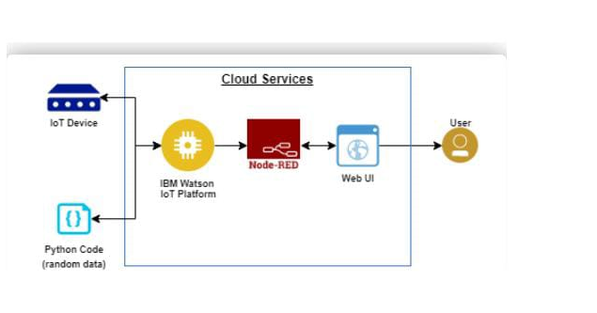
BLOCK DIAGRAM

Slide 5
IMPLEMENTATION TOOLS REQUIRED
IBM cloud platform
IBM Watson
IOT application development
Python programming language
Node Red editor

Slide 6
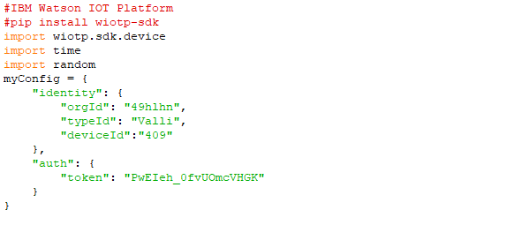
PYTHON CODE

Slide 7
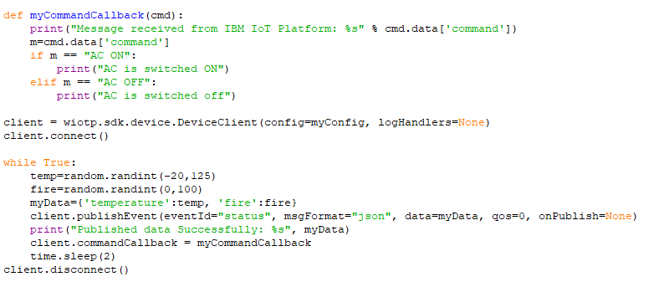

Slide 8
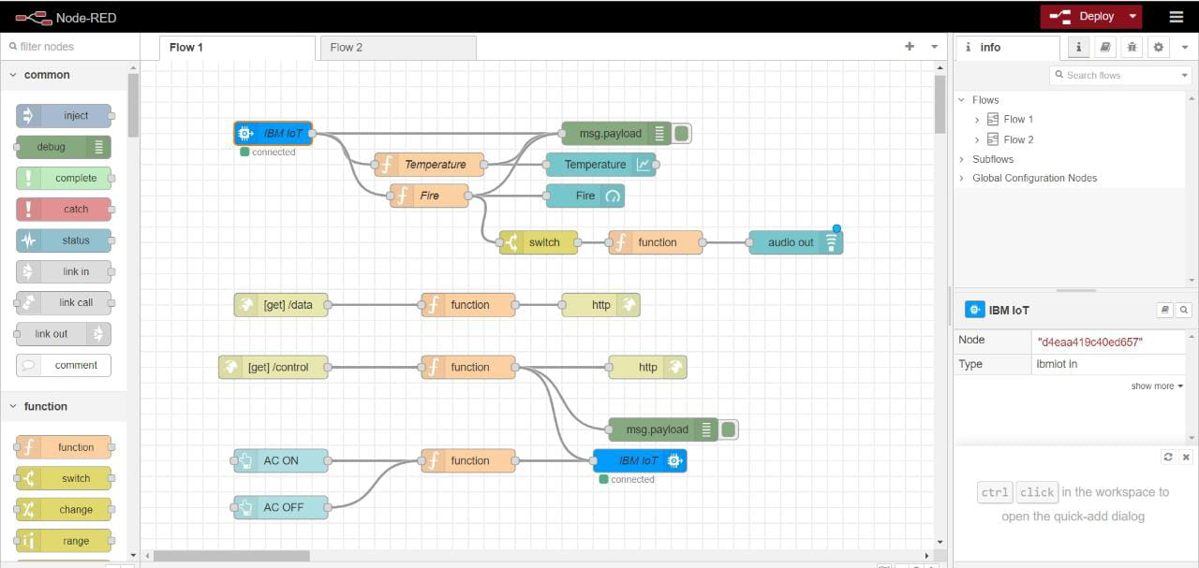
NODE RED FLOW

Slide 9
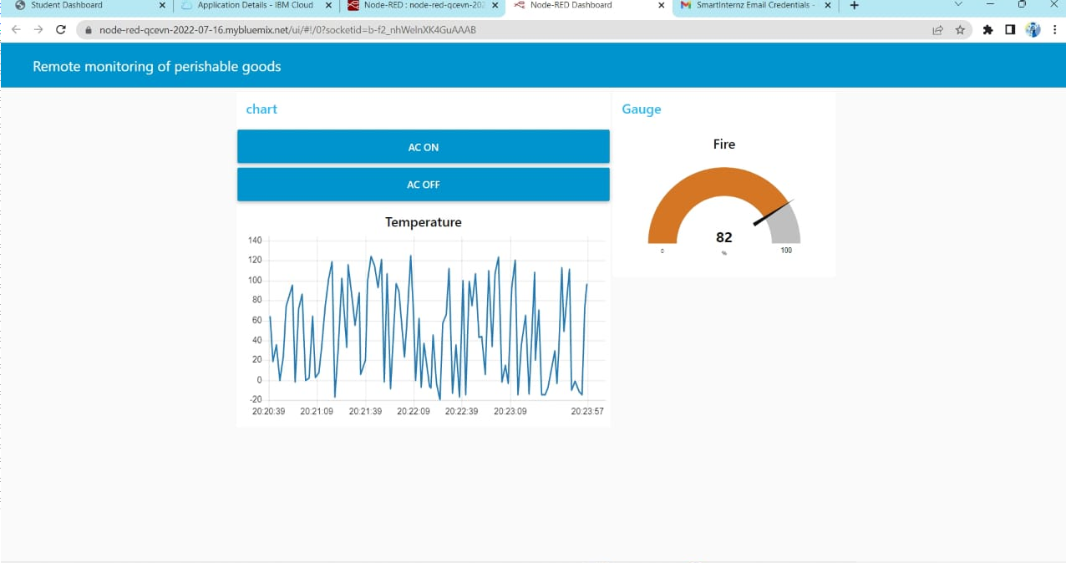
IMPLEMENTATION RESULTS

Slide 10
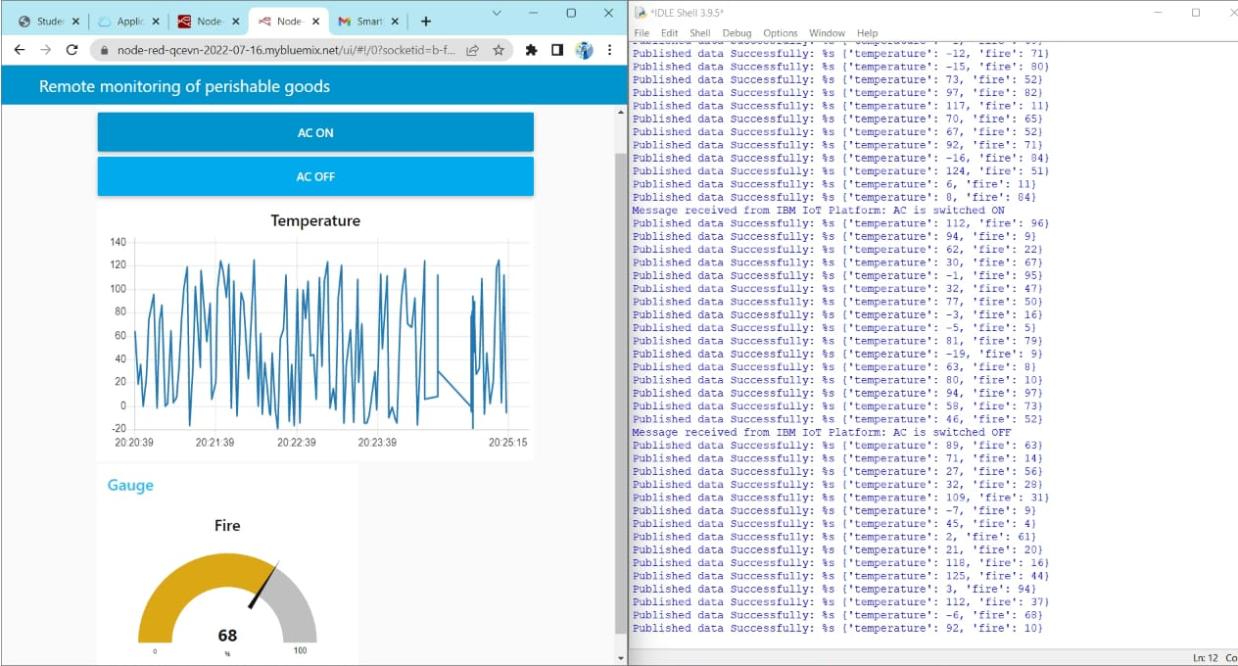
IMPLEMENTATION RESULTS

Slide 11
ADVANTAGES
Minimize human effort
Enhanced data collection
Improves patient’s life
Improved security and safety
Efficient resource utilization
Reduced use of other electronic equipment
Saves time and continuous monitoring
DISADVANTAGES
There could be wrong Analysis of Weather Conditions
Internet failures may effect system because it is highly dependent on internet
Initial cost and complexity is high
Increased Unemployement

Slide 12
APPLICATIONS
Monitoring Rooms in Hospitals (ICU’S)
Medical Stores
Food Storages
Industries and IOT Connected Factories
Shopping Malls

Slide 13
CONCLUSION
Remote monitoring of perishable goods plays important role in countries economy and human health, here the observations show that fused data provide accurate decision to the prevailing condition. The fused data was safely stored and made available to authorized users.
The system incorporated with information fusion is connected with cloud platform and was used for perishable goods quality monitoring continously.

Slide 14
THANK YOU

